Slide 1
PROJECT: TOOLS IN SIX SIGMA –
AN OVERVIEW
BY: SANDIP GUJAR PMP
ADMISSION NUMBER: HPGD/JA15/0102
SPECIALIZATION: OPERATIONS MANAGEMENT
PRIN. L.N. WELINGKAR INSTITUTE OF MANAGEMENT DEVELOPMENT & RESEARCH
Year of Submission: DECEMBER 2016

Slide 2
TOOLS IN SIX SIGMA – AN OVERVIEW
Six Sigma and its tools have created an impact in the operations of many companies.
Six Sigma tools can be utilized to promote improvements in quality both as a systematic and strategic manner.
Most of the taught Six Sigma tools are quality techniques that are not really new. What can be different is simply the application and integration of the tools.
Six Sigma tools are included in its Define-Measure-Analyze-Improve-Control (DMAIC) improvement project execution roadmap. This roadmap’s execution is to create robust processes that let businesses attain standards that are high and in control.
In Six Sigma, data are subjected to analysis in order to better comprehend problems and identify customer needs. The phases of Six Sigma are to quantify possible defects and its causes, along with the reduction of process waste.

Slide 3
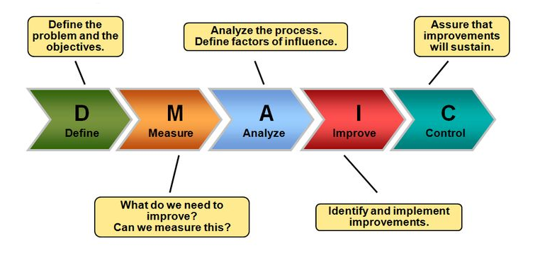
DMAIC ROADMAP

Slide 4
TOOLS FOR THE DEFINE PHASE OF DMAIC
Define phase involves :
  identifying the quality characteristics that are critical to customers (called CTQs) and operationally defining them,
  using SIPOC (acronym for Supplier, Input, Process, Output and Customer) analysis,
  a voice of the customer analysis for preparing a business case for the project with a project objective,
  A project charter to identify the problem
  Stakeholder analysis to define the stakeholders and their requirements
  DMAIC Work Breakdown Structure (WBS) to set the goals

Slide 5
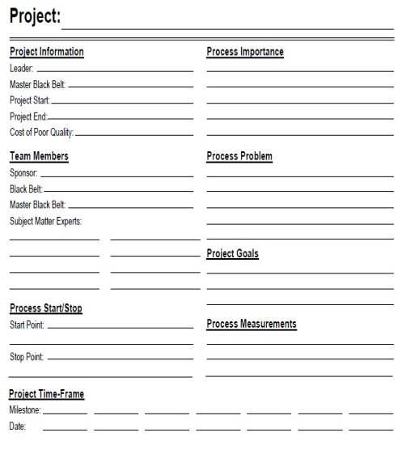
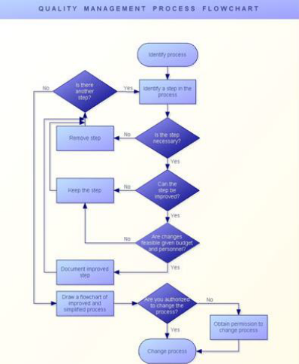
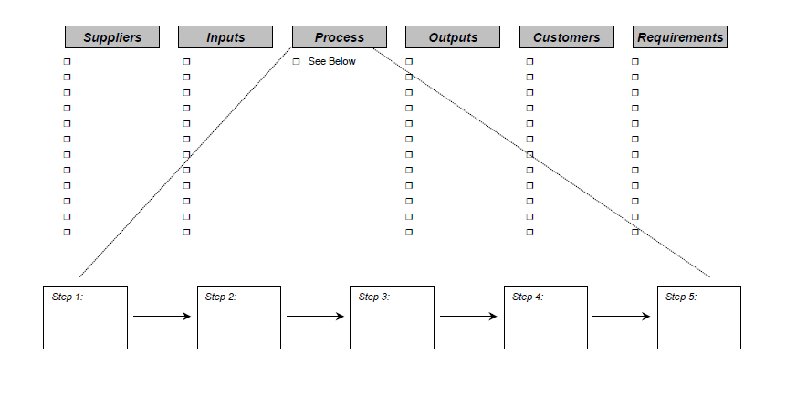
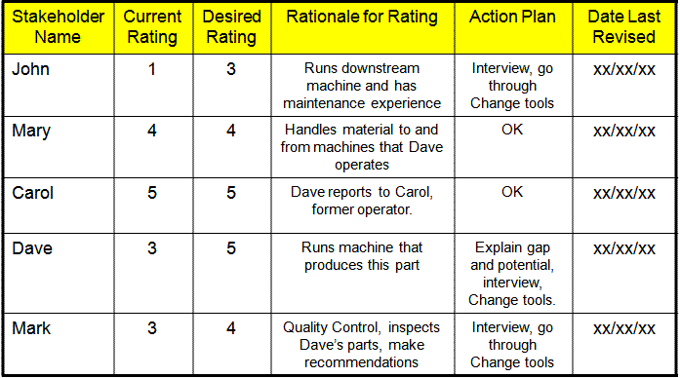
SOME TOOLS IN THE DEFINE PHASE
Project Charter
Process Map
SIPOC Diagram
Stakeholder analysis

Slide 6
TOOLS FOR THE MEASURE PHASE OF DMAIC
Measure phase involves:
conducting studies of the validity of the measurement system/gage R&R of the CTQs,
collecting baseline data for the CTQs and
establishing baseline capabilities for the CTQs,
identifying input and process variables (called Xs) that affect each CTQ using process maps or flowcharts,
Validate problem/process and Benchmarking
Refine problem/goal using Voice of the Customer
Process Sigma Calculation by measure key steps/inputs

Slide 7
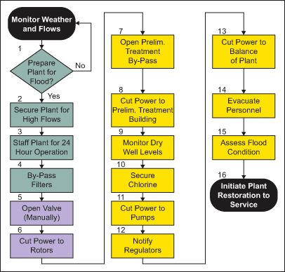
SOME TOOLS IN THE MEASURE PHASE
 | Continuous data (Variables) | Discrete data (Attributes)
Definition | This is information that can be measured on a continuum or scale e.g. Weight of packages sent Customer wait time for every customer service call Average speed of cars traveling in a highway | This is a whole number (or count) of attributes like : Number of people buying a product Number of defects per 1000 events Number of satisfied customers
Identification | To identify continuous data, ask the question whether the data can be expressed to any desired level of precision or decimal point e.g. What is the distance covered by the car? This can be answered as 1 mile, 1.1 miles, 1.1.1 miles etc. Any data that can be measured to any desired level of precision is called continuous data. | To identify discrete data, ask the question whether the data can be expressed by 1 level of precision e.g. Is your age equal to or greater than 35 years? This can be answered as Yes or No. There is no further level of precision possible. So, the data type is discrete
Tools used | Data collection: Demographic questions (e.g. age etc.), fill-in-the-blank questions (e.g. distance covered, temperature, humidity etc.) | Data collection: Ranking, Rating, Yes/No questions etc. – covered in chapter 2: Stakeholders, Customers and financial measures
Process Map
If the Yield is | DPMO would be | Sigma would be
30.9% | 6,90,000 | 1.0
69.2% | 3,08,000 | 2.0
93.3% | 66,800 | 3.0
99.4% | 6,210 | 4.0
99.98% | 320 | 5.0
99.9997% | 3.4 | 6.0
Data collection Table
Yield to Sigma Conversion Table

Slide 8
TOOLS FOR THE ANALYZE PHASE OF DMAIC
Analyze phase involves:
  creating a cause-and-effect/Fishbone to understand the relationships between the Xs and the CTQs,
  conducting an FMEA (Failure Mode and Effects Analysis) to identify the critical Xs for each CTQ,
  conducting studies of the validity using Histogram, Pareto Chart, Run Chart and Scatter Plot,
  Identify “vital few” root causes using Regression Analysis,5 Whys and the cause-and-effect/Fishbone diagram.

Slide 9
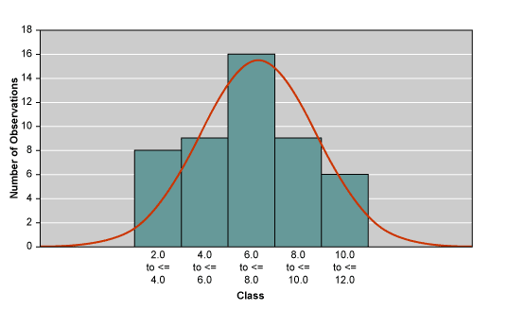
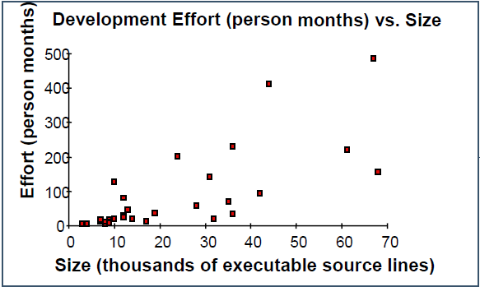
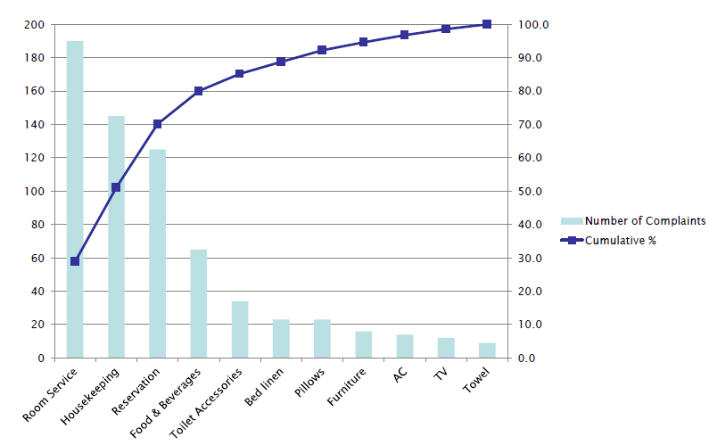
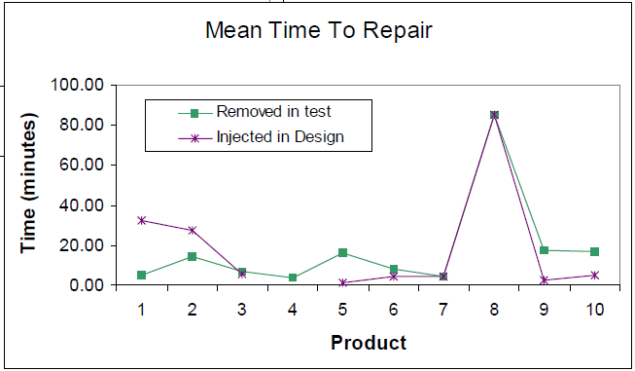
SOME TOOLS IN THE ANALYZE PHASE
Scatter Plot
Histogram
Pareto
Run Chart

Slide 10
TOOLS FOR THE IMPROVE PHASE OF DMAIC
Improve phase involves:
designing appropriate experiments (DOE) to understand the relationships between the Xs that impact CTQs,
generating the actions needed to implement optimum levels of critical Xs that minimize spread in CTQs using Brainstorming,
conducting pilot tests of processes with Xs set at their optimum levels using Simulation Software and Pugh Matrix,
Develop ideas to remove root causes using QFD/House of Quality,
Test solutions using Failure Modes and Effects Analysis (FMEA),
Standardize solution/measure results using Mistake Proofing (Poka – Yoke).

Slide 11
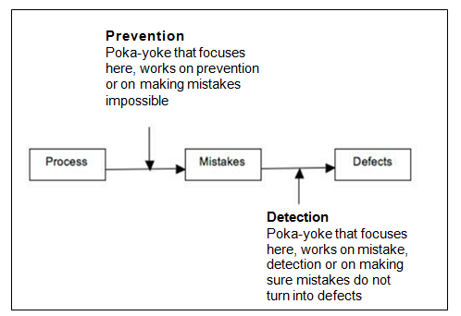
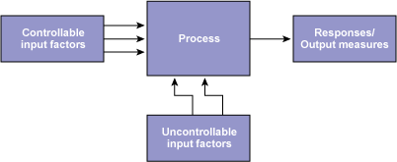
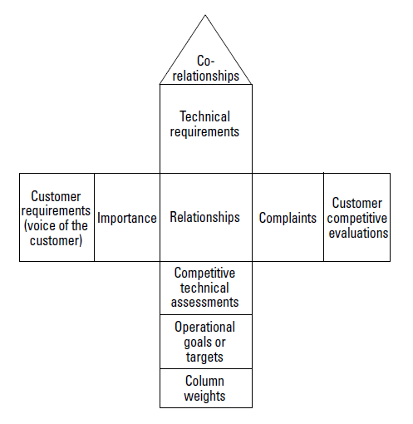
SOME TOOLS IN THE IMPROVE PHASE
Poka Yoke
Process Factors and Responses
 | Solutions
Selection Criteria | Baseline – Current Car | Car A | Car B | Car C
Fuel system | 0 | -2 | 2 | -1
Four-door | 0 | 2 | 2 | -2
Miles per gallon | 0 | 2 | 2 | 0
Sound system | 0 | 1 | 2 | -1
Warranty plan | 0 | 0 | 2 | -1
Pugh Matrix Table
Basics of QFD

Slide 12
TOOLS FOR THE CONTROL PHASE OF DMAIC
Control phase involves:
avoiding potential problems in Xs with risk management and Cost Savings Calculations,
standardizing successful process changes, controlling the critical Xs using Control Charts,
developing process control plans for the critical Xs, and documenting the control plans and turning over the control plan to the process owner,
Establish standard measures to maintain performance and correct problems as needed by Process Sigma Calculation.

Slide 13
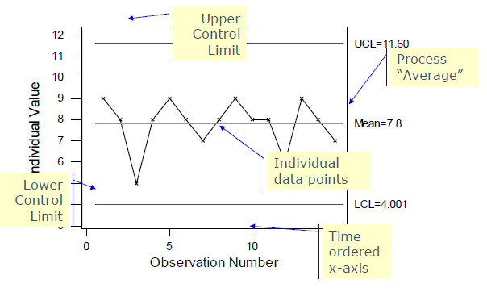
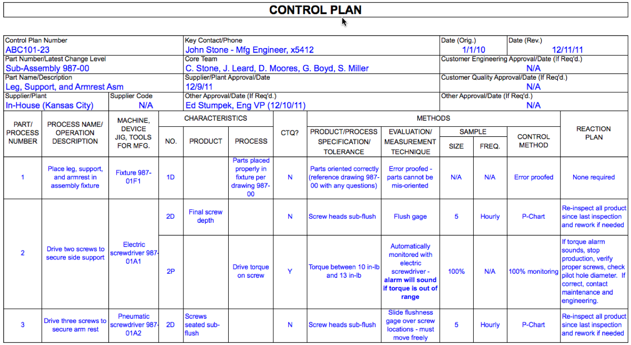
SOME TOOLS IN THE CONTROL PHASE
Control Chart
Control Plan

Slide 14
RECOMMENDATIONS
By using these tools in the DMAIC process:
  can improve any type of process in any organization,
  improves the quality of goods and services
  achieves the goal to improve efficiency and effectiveness,
  minimizing mistakes and maximizing values
  drive quality improvements, within an organization, focused around the DMAIC model
  most of these tools are frequently used as quality methods that have been around for years together.
  Increases profits with emphasis on:
      Improving customer satisfaction
      Building market share
      Gaining competitive advantage and
      Sustainability in the market.

Slide 15
CONCLUSION
In the tools discussed, effort is primarily aimed at cost reductions by eliminating waste (scrap, inefficiencies, excess materials, rework, etc.) that increases cost but adds no value.
These tools produce a financial benefit, either directly or indirectly, through cost reductions, revenue growth, balance sheet improvements or accomplishing strategic goals.
With the advancement of technology the effective implementation of these tools has been computerized (many software are available) and there is no doubt that successful implementation of these tools has a future direction to progress. These tools will replace reactive habits with a dynamic, responsive, proactive style of management.
The tools used under DMAIC methodology, can be applied to any process.

Slide 16
CONCLUSION (CONTINUED…)
These tools bring together years of diverse process improvement techniques and data analysis, into a structured step by step format.
The aim is to measure defects and/or error rates; find and eliminate root causes to problems created by process and reduce the costs of products/services by eliminating defects.
This results in a more robust process that consistently achieves a higher standard of output –which is capable and in control!
“What gets managed, gets measured”
– Peter Drucker
“THANK YOU ALL!”

